Slide 1
STS Global Test Data Management
NI STS Test Program Development Best Practice
Matthew Roberts
NI Senior Field Applications Engineer

Slide 2
Overview
STS Global Test Data Management
Problem Statement (why is this needed?)
Overview of TSM Data Access Technique
Workflows
Adding Global Test Data to Existing Project
Creating A New Property
Using Global Test Data Properties in Code Modules
Initializing Global Test Data in ProcessSetup
Taking this concept to the next level!

Slide 3
Problem Statement
STS Global Test Data Management
Why is this needed?
Pros/Cons

Slide 4
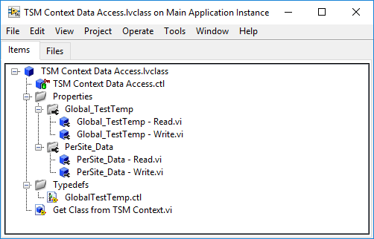
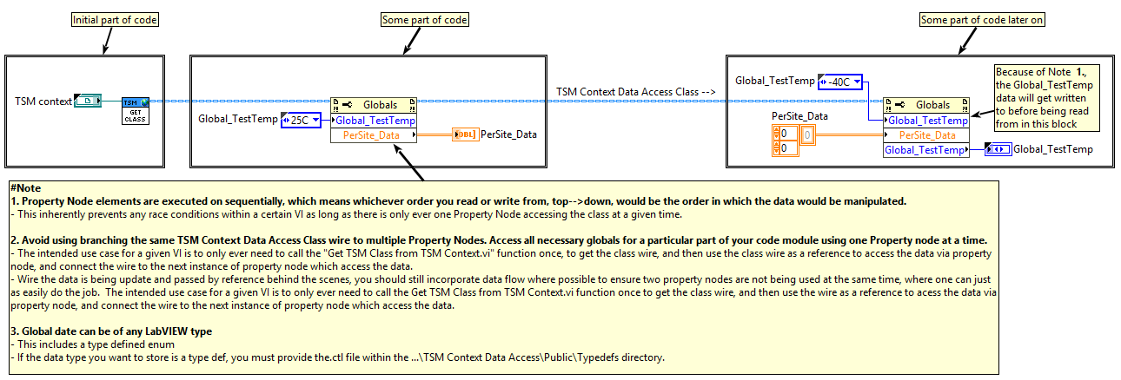
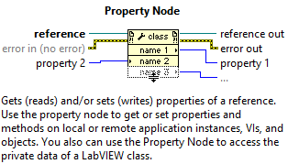
Overview of TSM Data Access Technique
STS Global Test Data Management
Convenient Test Program Data Storage, Access, & Management
Uses Semiconductor Module Context & corresponding API as the means for memory storage
Global & Per-Site Capable
Extracts data types & sites management away from the users
Based on a flat LabVIEW Class with a pre-defined set of Properties
Read & Write accessor functions created for each individual data item being stored
Only two LabVIEW nodes needed during test program development
Get Class.vi
Property Nodes
Used to invoke pre-defined read/write accessor functions for a given data item
Scalable to add as many data items as needed throughout the development process

Slide 5
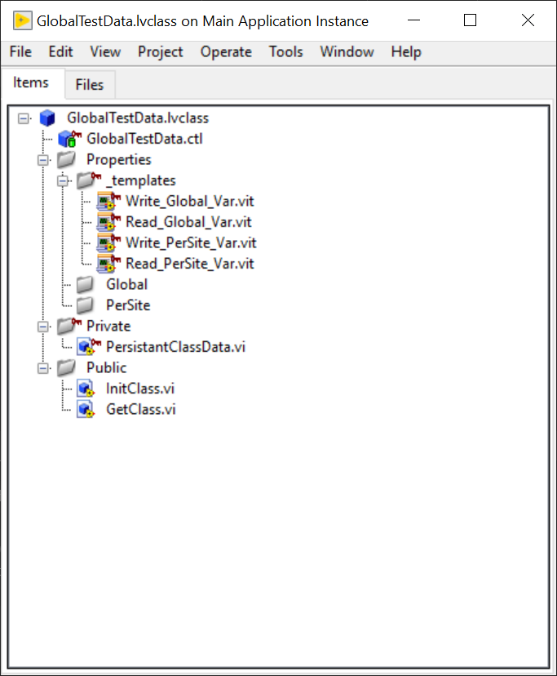
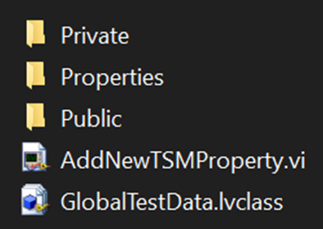
Global Test Data Template Files
STS Global Test Data Management
Template files available on GitHub:
https://github.com/Mattjet27/STSGlobalTestDataTemplate
Includes:
GlobalTestData LabVIEW class
Property VI Templates - Global & PerSite
AddNewTSMPropery.vi - scripts new properties and adds them to the GlobalTestData class automatically based on the name and scope specified by front panel controls.
Note: these templates files can but should not be modified.

Slide 6
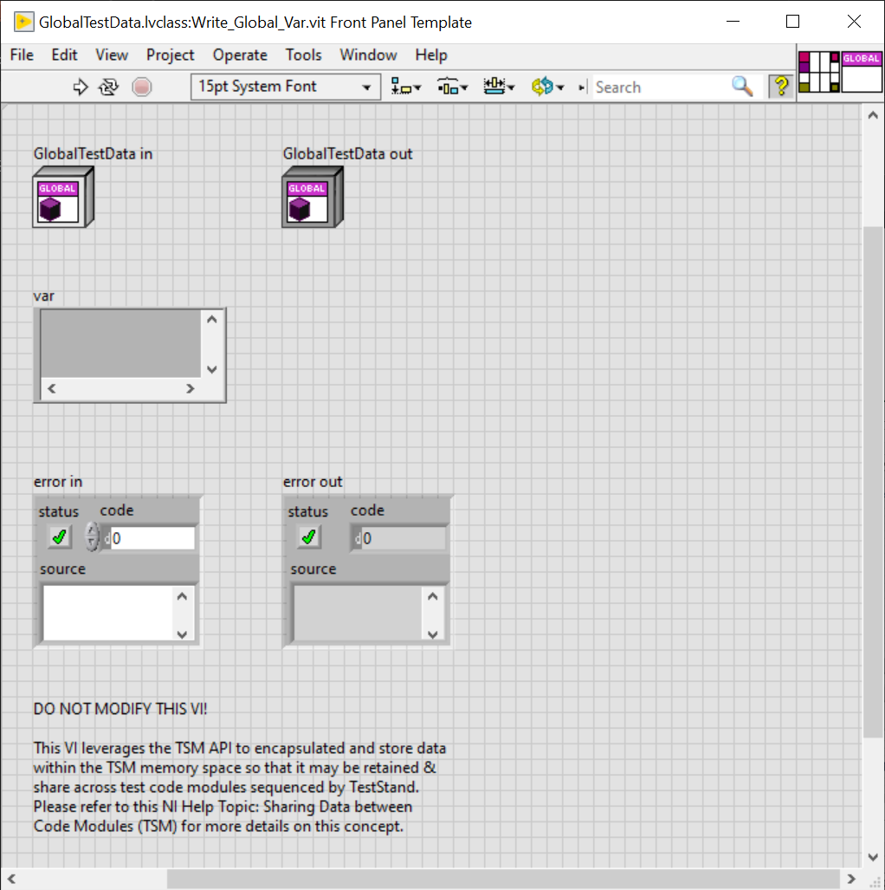
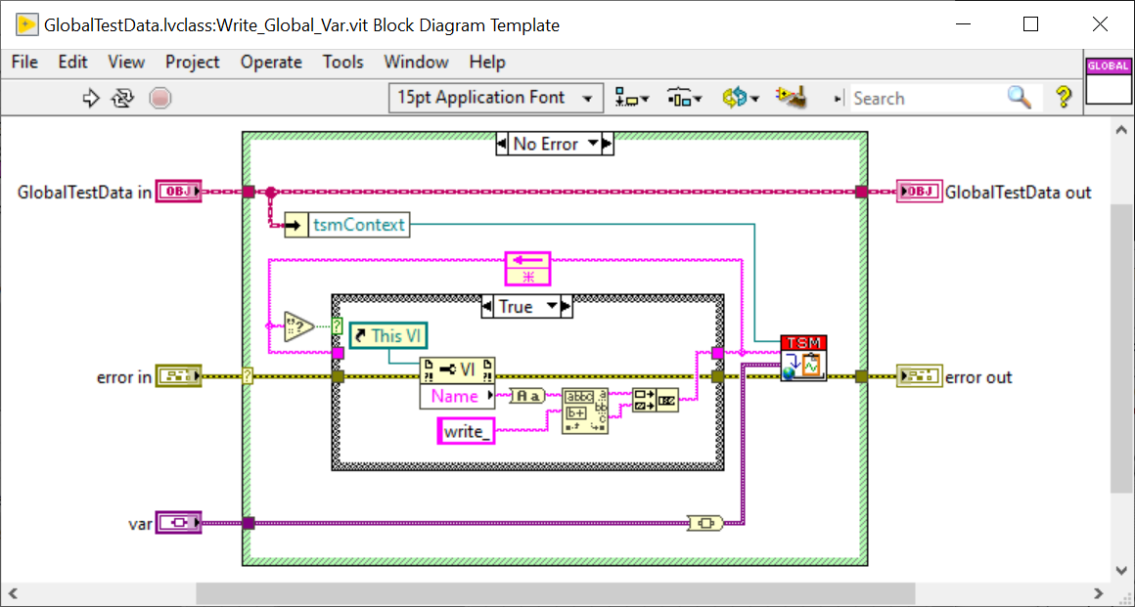
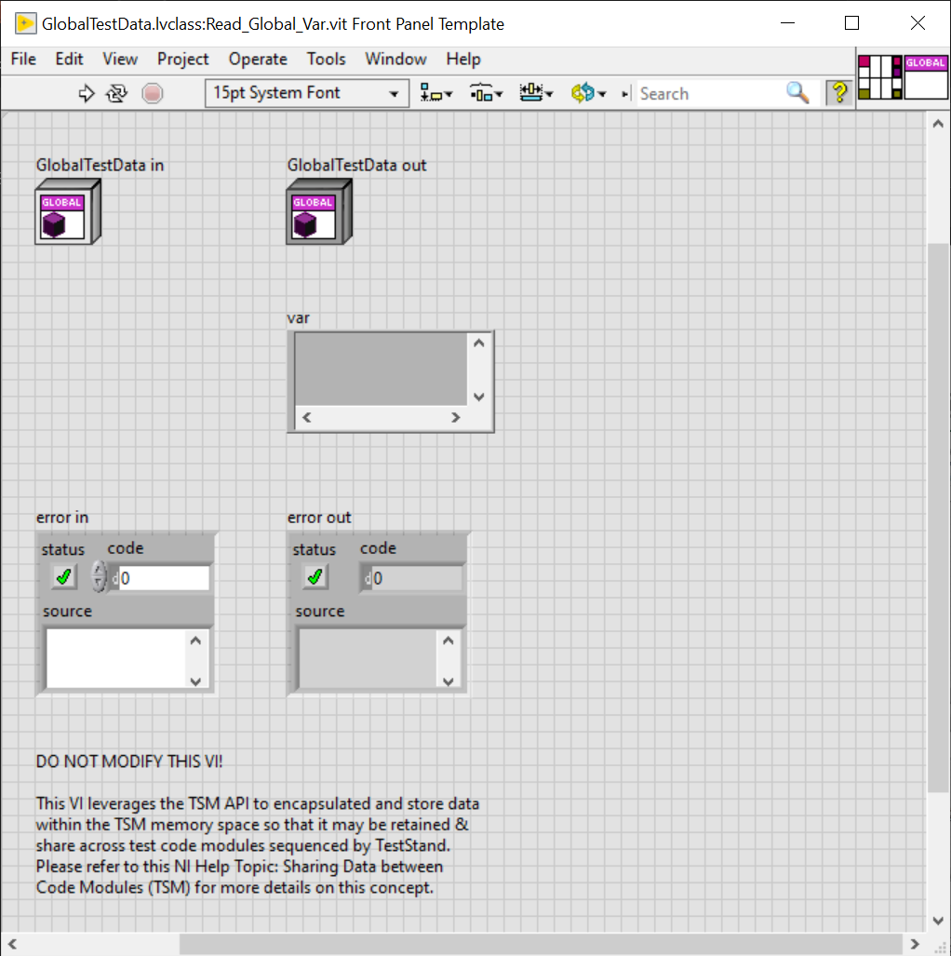
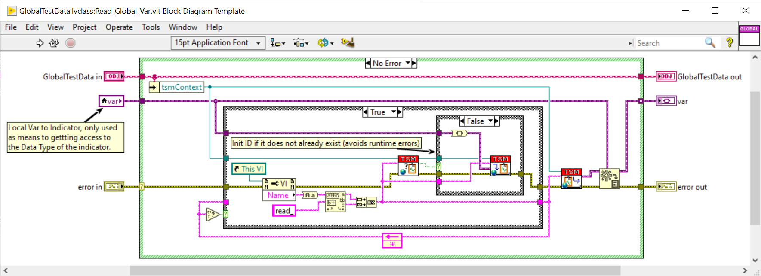
Read/Write Template VI - Global
STS Global Test Data Management

Slide 7
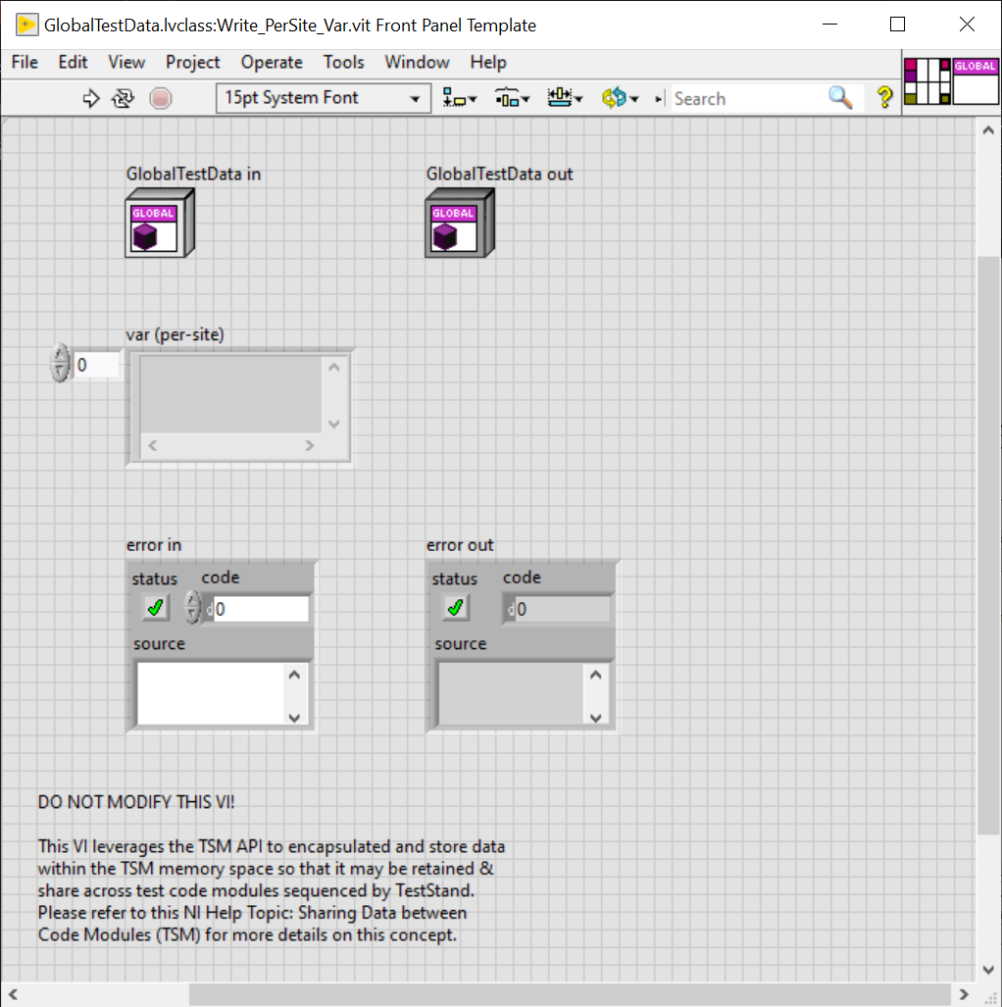
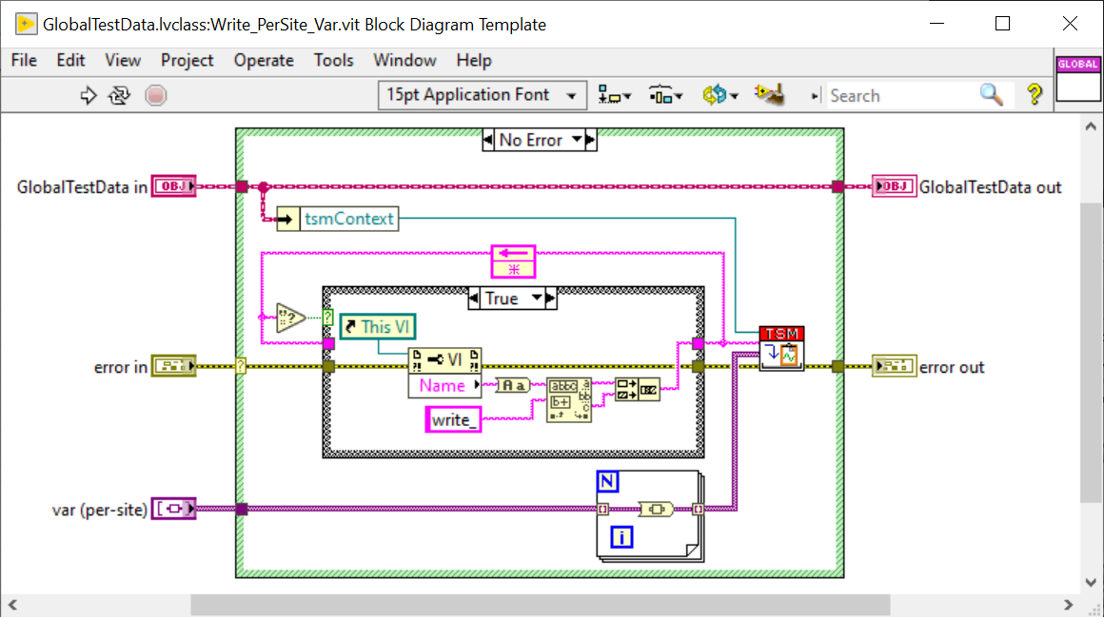
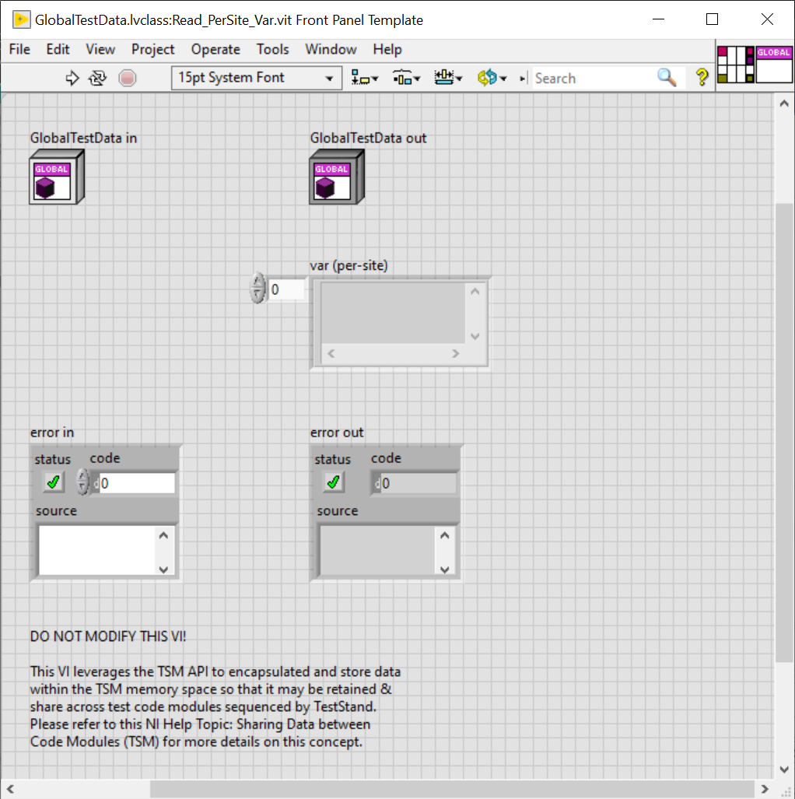
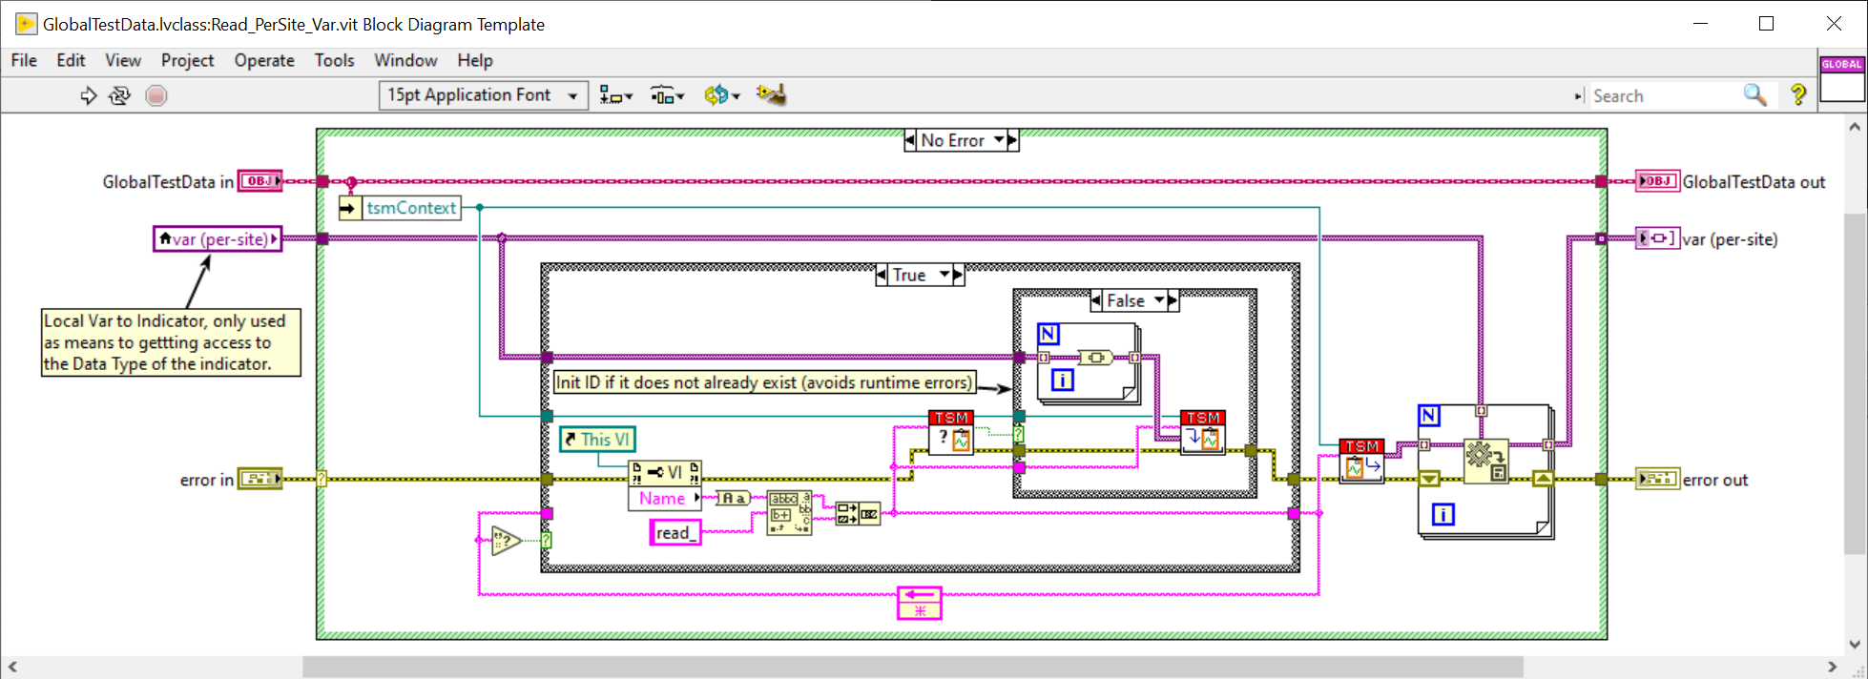
Read/Write Template VI - PerSite
STS Global Test Data Management

Slide 8
Workflow – Adding Global Test Data to Existing Project
STS Global Test Data Management
Download the Global Test Data template files from GitHub
Copy or move the GlobalTestData directory into the Code Modules/Common directory of your test program’s source
Ensure Code Modules/Common/GlobalTestData has been added to the LabVIEW project
Define & add new application specific properties to the Global Test Data class
Create both a Read & Write VI for each new property.
Refer to proceeding slides labeled: “Workflow – Creating A New Property slides”
Repeat as needed to scale during test program development
Notes:
https://github.com/Mattjet27/STSGlobalTestDataTemplate

Slide 9
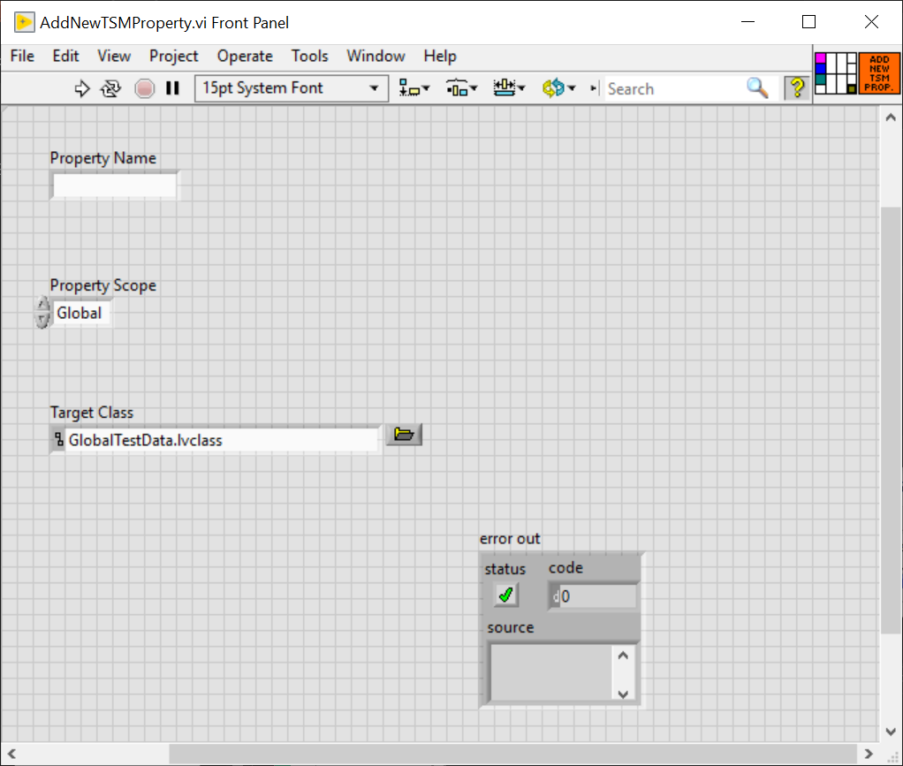
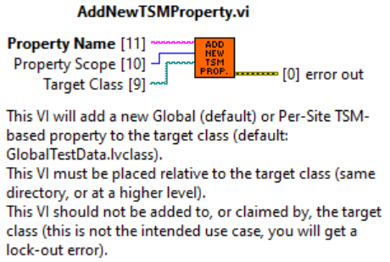
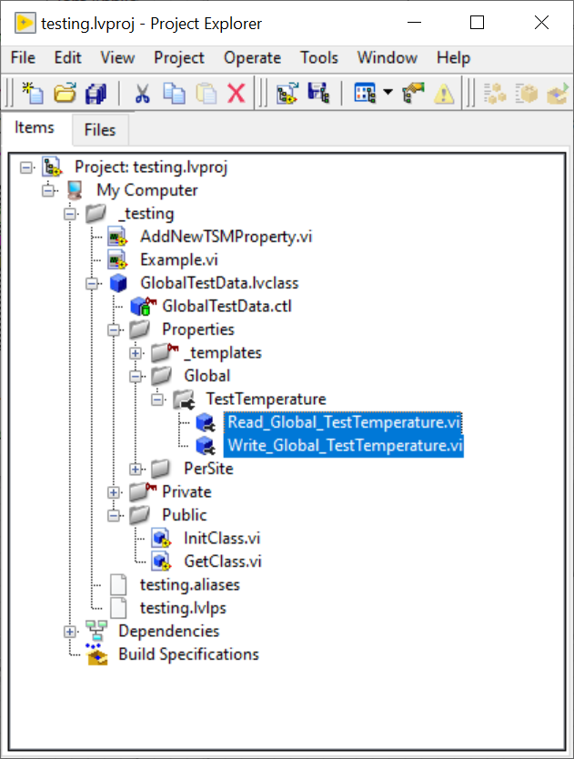
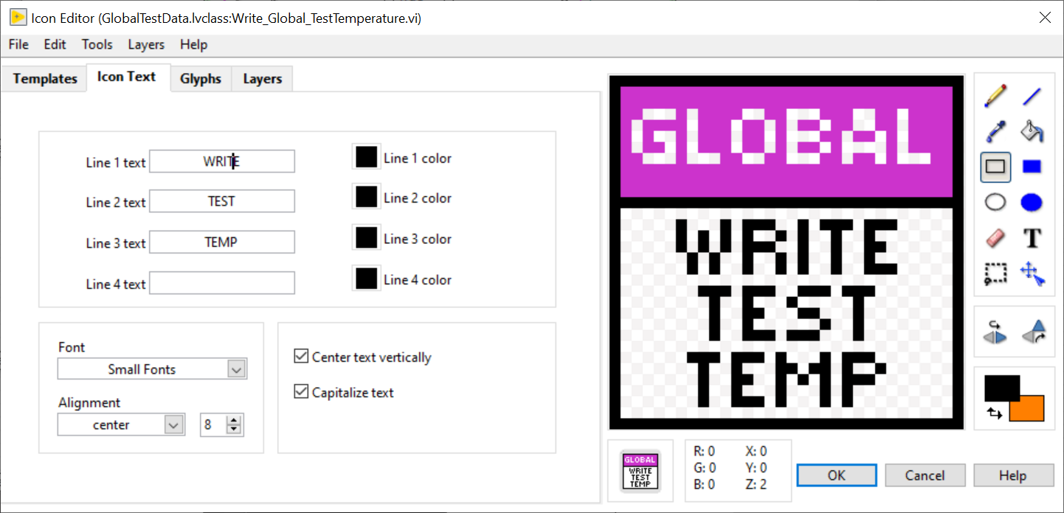
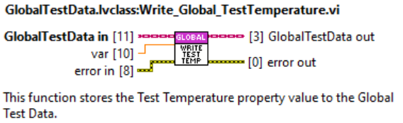
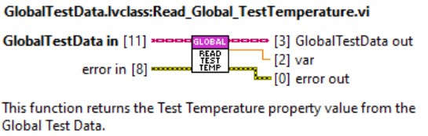
Workflow – Creating A New Property (Scripted Method)
STS Global Test Data Management
Open the AddNewTSMProperty.vi
Input the desired property name into the Property Name control
Select either Global or PerSite from the Property Scope control to set the property’s scope.
Global scope – single value at runtime for all sites (site agnostic).
PerSite scope – separate values at runtime for each site defined by pin map (site unique)
Run the AddNewTSMProperty VI
After the VI finishes executing, locate the newly created properties from within the LabVIEW Project Explore window
Open both the Write_<scope>_<name>.vi & Read_<scope>_<name>.vi modify the following:
Right click the variant control/indicator (make sure to hover over just the element if scope is PerSite) and select replace, then choose the appropriate data type for the property.
Note that the data type must match between both VIs or the run arrow for both VIs will be broken.
Update the VI Icon of both functions to match the property name. For example, if the property name is TestTemperature see example below
Edit the VI Properties to add documentation to each VI as well.

Slide 10
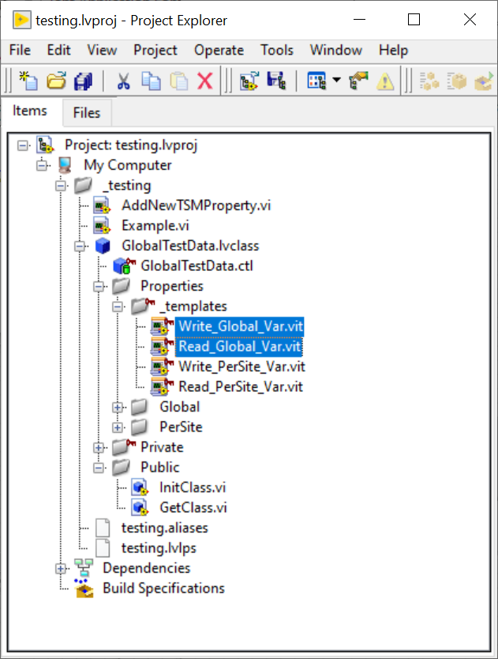
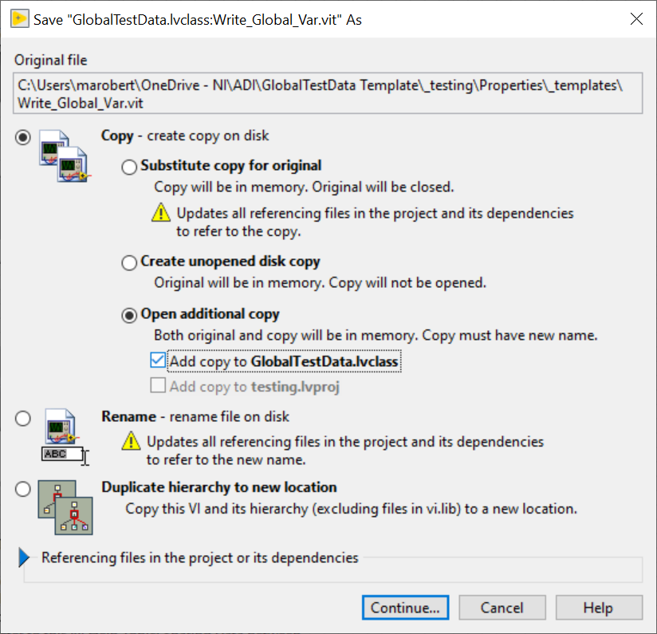
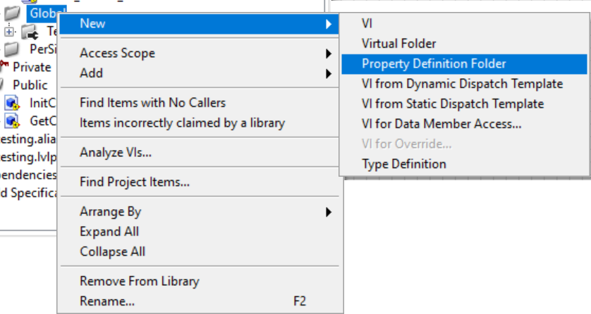
Workflow – Creating A New Property (Manual Method)
STS Global Test Data Management
Locate the _templates private virtual folder of the GlobalTestData.lvclass from within the LabVIEW Project Explore window
Open the appropriate Write template file for the desired scope (Global or PerSite) and then Save As with the Open additional copy: Add copy to GlobalTestData.class option selected.
Global scope – single value at runtime for all sites (site agnostic).
PerSite scope – separate values at runtime for each site defined by pin map (site unique)
Save the new Write VI with the following file naming convention and save it to the GlobalTestData/Properties directory on disk: Write_<scope>_<name>.vi
Repeat steps 2 & 3 with the Read template file, naming the copy Read_<scope>_<name>.vi
From within the LabVIEW Project Explore window, locate and expand the Properties virtual folder of the GlobalTestData.lvclass and right click the appropriate virtual folder for the scope selected (Global or PerSite) and choose New→Property Definition Folder
Rename the newly created Property Definition Folder to the name you have chosen for the new property.
From within the LabVIEW Project Explore window, move the both the Write_<scope>_<name>.vi & Read_<scope>_<name>.vi files you created in steps 2-4 into the newly created Property Definition Folder.
Open both the Write_<scope>_<name>.vi & Read_<scope>_<name>.vi modify the following:
Right click the variant control/indicator (make sure to hover over just the element if scope is PerSite) and select replace, then choose the appropriate data type for the property.
Note that the data type must match between both VIs or the run arrow for both VIs will be broken.
Update the VI Icon of both functions to match the property name. For example, if the property name is TestTemperature see example below
Edit the VI Properties to add documentation to each VI as well.

Slide 11
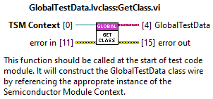
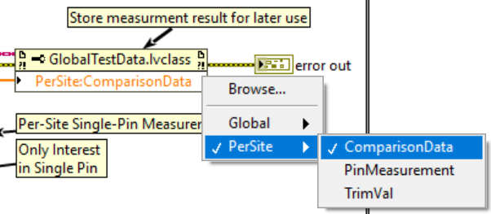
Workflow – Using Global Test Data Properties in Code Modules
STS Global Test Data Management
Accessing Data During Code Module Development
Drop down the GlobalTestData.lvclass:Get Class.vi onto the block diagram of your code module and wire the Semiconductor Module context to its top input terminal (TSM Context).
Drop down a LabVIEW Property Node (any type) and wire the GlobalTestData class wire from the Get Class from TSM Context.vi’s output terminal to the Property Node’s input terminal.
Make sure to also wire up the error wires appropriately.
Click to select the items to access within the property node and drag the bottom of the property node to expand out the number of items to be accessed.
Note: right clicking the item within the property node will allow you to change whether to read or right to that property, it will read by default unless changed. It will also give you an option to open the accessor function if it needs to be reviewed or modified.
Notes:
#Notes
1. Property Node elements are executed on sequentially, which means whichever order you read or write from, top-->down, would be the order in which the data would be manipulated.
- This inherently prevents any race conditions within a certain VI as long as there is only ever one Property Node accessing the class at a given time.
2. Avoid using branching the same TSM Context Data Access Class wire to multiple Property Nodes. Access all necessary globals for a particular part of your code module using one Property node at a time.
- The intended use case for a given VI is to only ever need to call the "Get TSM Class from TSM Context.vi" function once, to get the class wire, and then use the class wire as a reference to access the data via property node, and connect the wire to the next instance of property node which access the data.
- Wire the data is being update and passed by reference behind the scenes, you should still incorporate data flow where possible to ensure two property nodes are not being used at the same time, where one can just as easily do the job. The intended use case for a given VI is to only ever need to call the Get TSM Class from TSM Context.vi function once to get the class wire, and then use the wire as a reference to acess the data via property node, and connect the wire to the next instance of property node which access the data.
3. Global date can be of any LabVIEW type
- This includes a type defined enum
- If the data type you want to store is a type def, you must provide the.ctl file within the ...\TSM Context Data Access\Public\Typedefs directory.

Slide 12
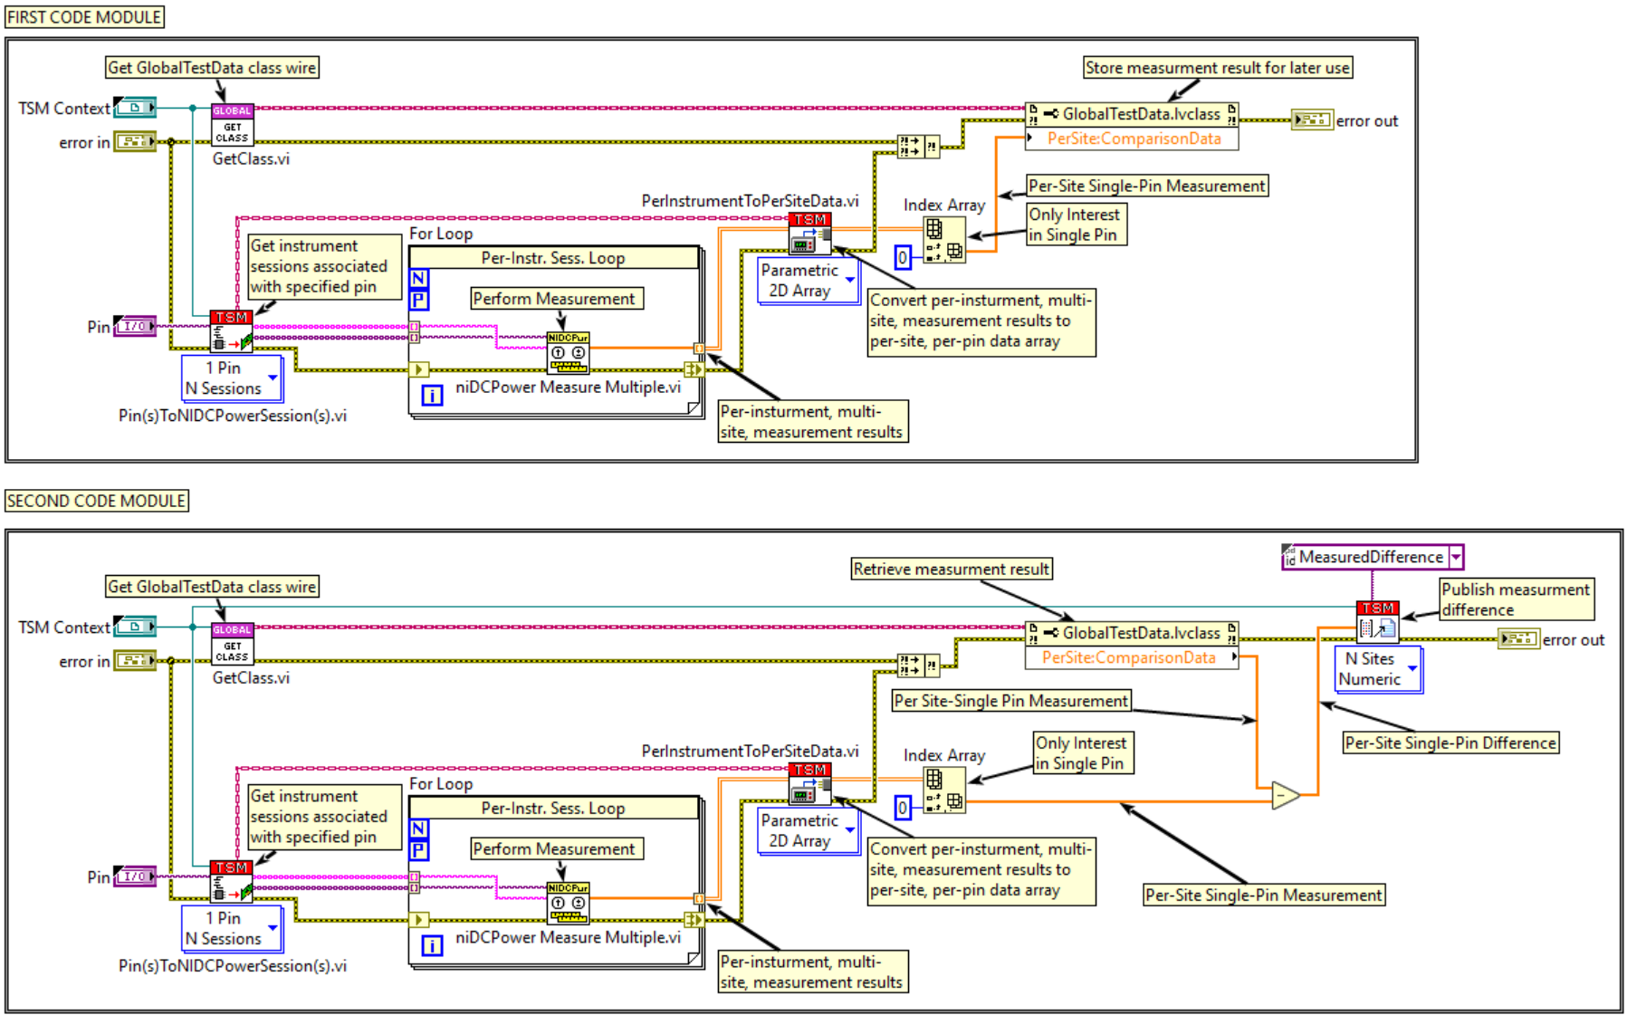
Example – Sharing Global Test Data Between Code Modules
STS Global Test Data Management

Slide 13
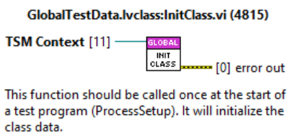
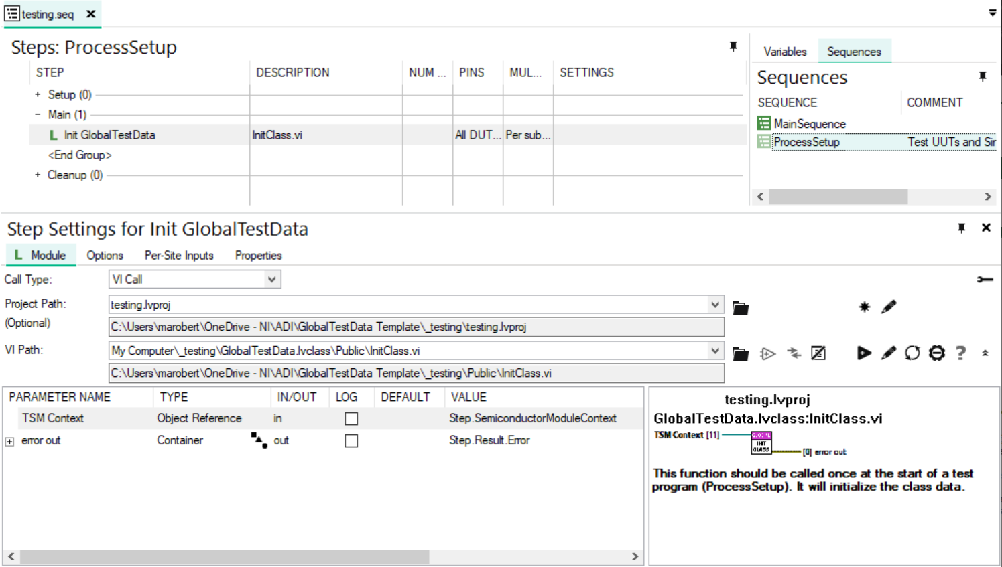
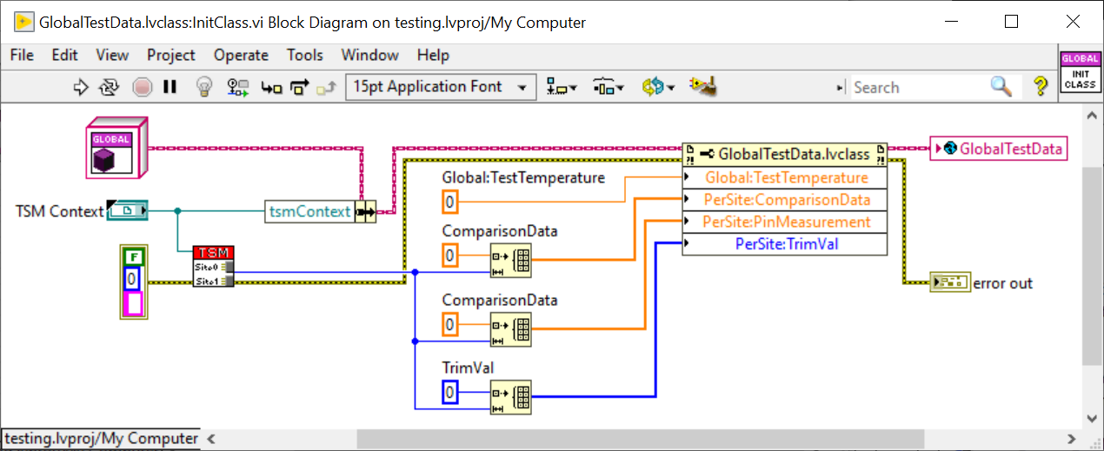
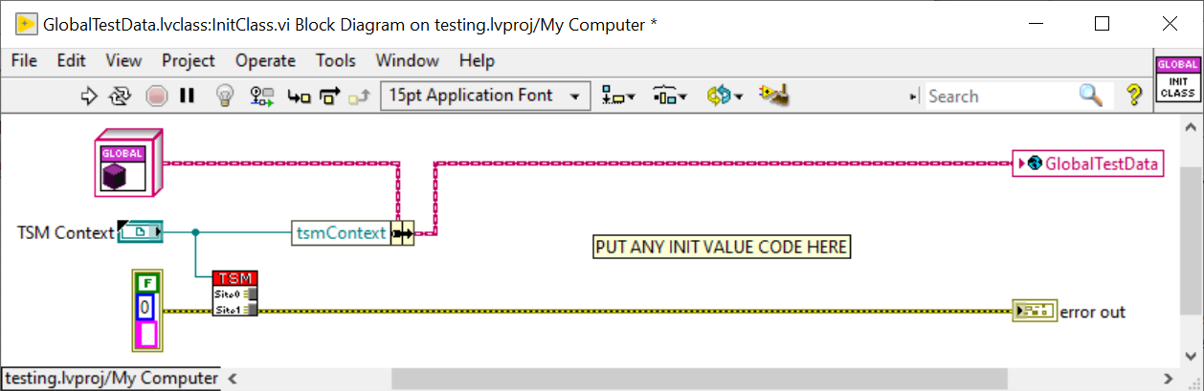
Workflow – Initializing Global Test Data in ProcessSetup
STS Global Test Data Management
The InitClass.vi in the GlobalTestData class must be called from TestStand in ProcessStep within the Test Program’s sequence file.
Inside this VI is where initial values of the Global Test Data properties should be defined and will be instantiated when a lot starts.

Slide 14
Taking this concept to the next level!
STS Global Test Data Management
This concept of class-based data encapsulation in LabVIEW can be used for other application specific class types in your Test Program, not just Global Test Data.
You may want to explore creating your own class template for an application specific class type, such a Fuse data.
Making Data Private & Adding Methods
Any property in the Class can be marked as private, meaning only a VI claimed by the class (i.e. a class method) can access on that data from a property node.
Data can further be encapsulated by making properties private and only accessing or acting on the data via the use of class methods.
While methods should not be added for the Global Test Data use case, the LabVIEW class can incorporate data specific methods to act on the data however you see fit.

